Slide 1

Drexel Study Buddies
Tomer Shemesh
Bret Davis
Scott Miller
Kelly Shiptoski

Slide 2
Our Project
DU Study Buddies is an android app for Drexel students to create or join study groups for the classes in which they are enrolled

Slide 3
Project Features
Authenticates drexel students using Drexel’s mobile API
Loads student’s current class list and shows suggested groups for those classes
Students can create or join study groups
Students can search all available study groups by class

Slide 4
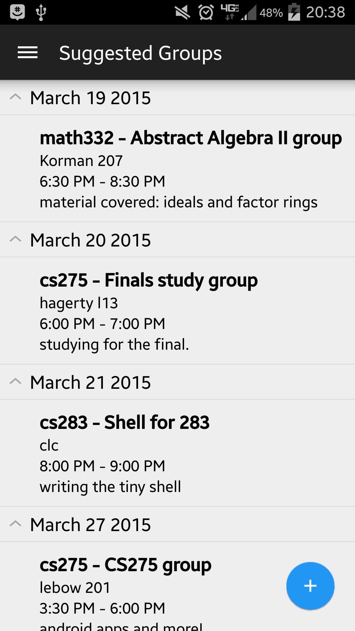
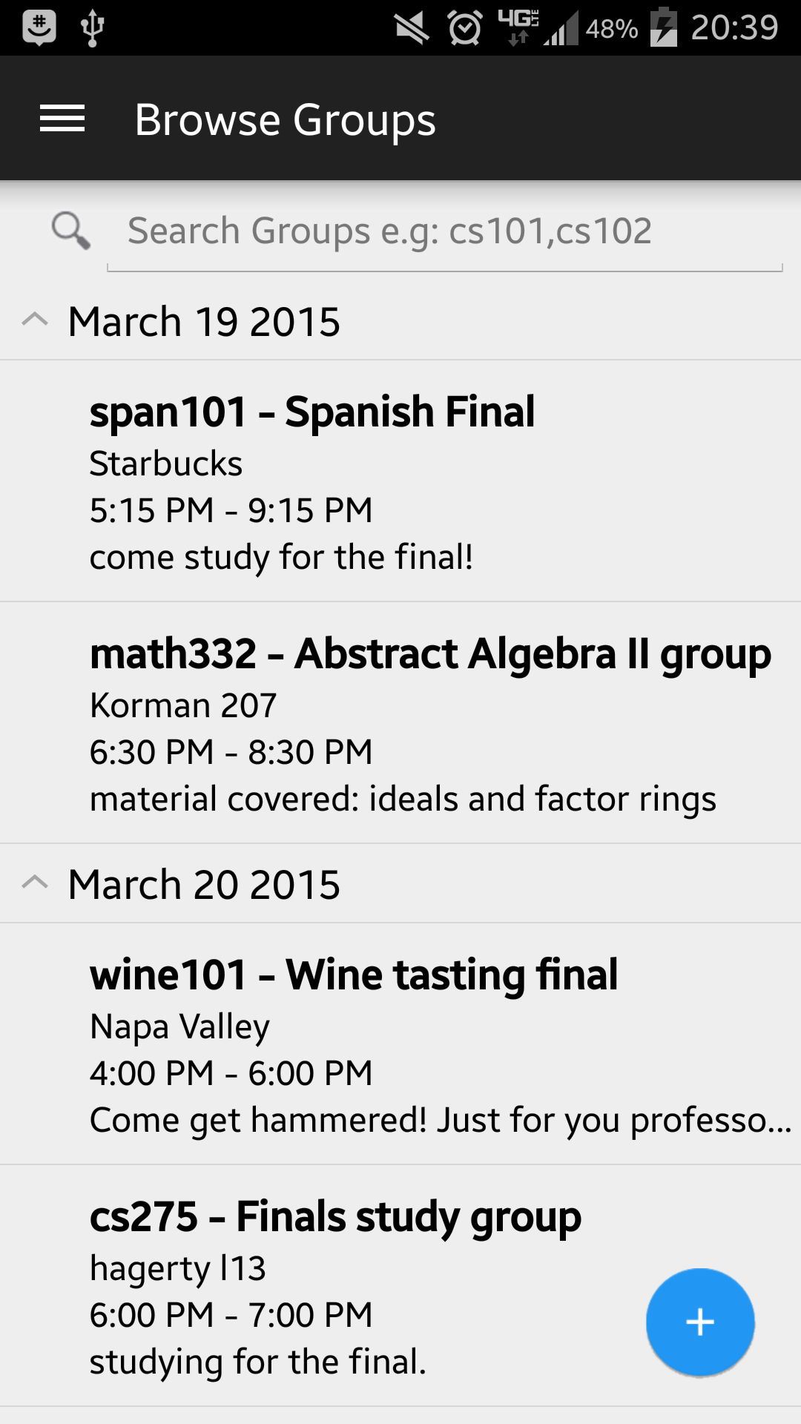
Usage

Slide 5
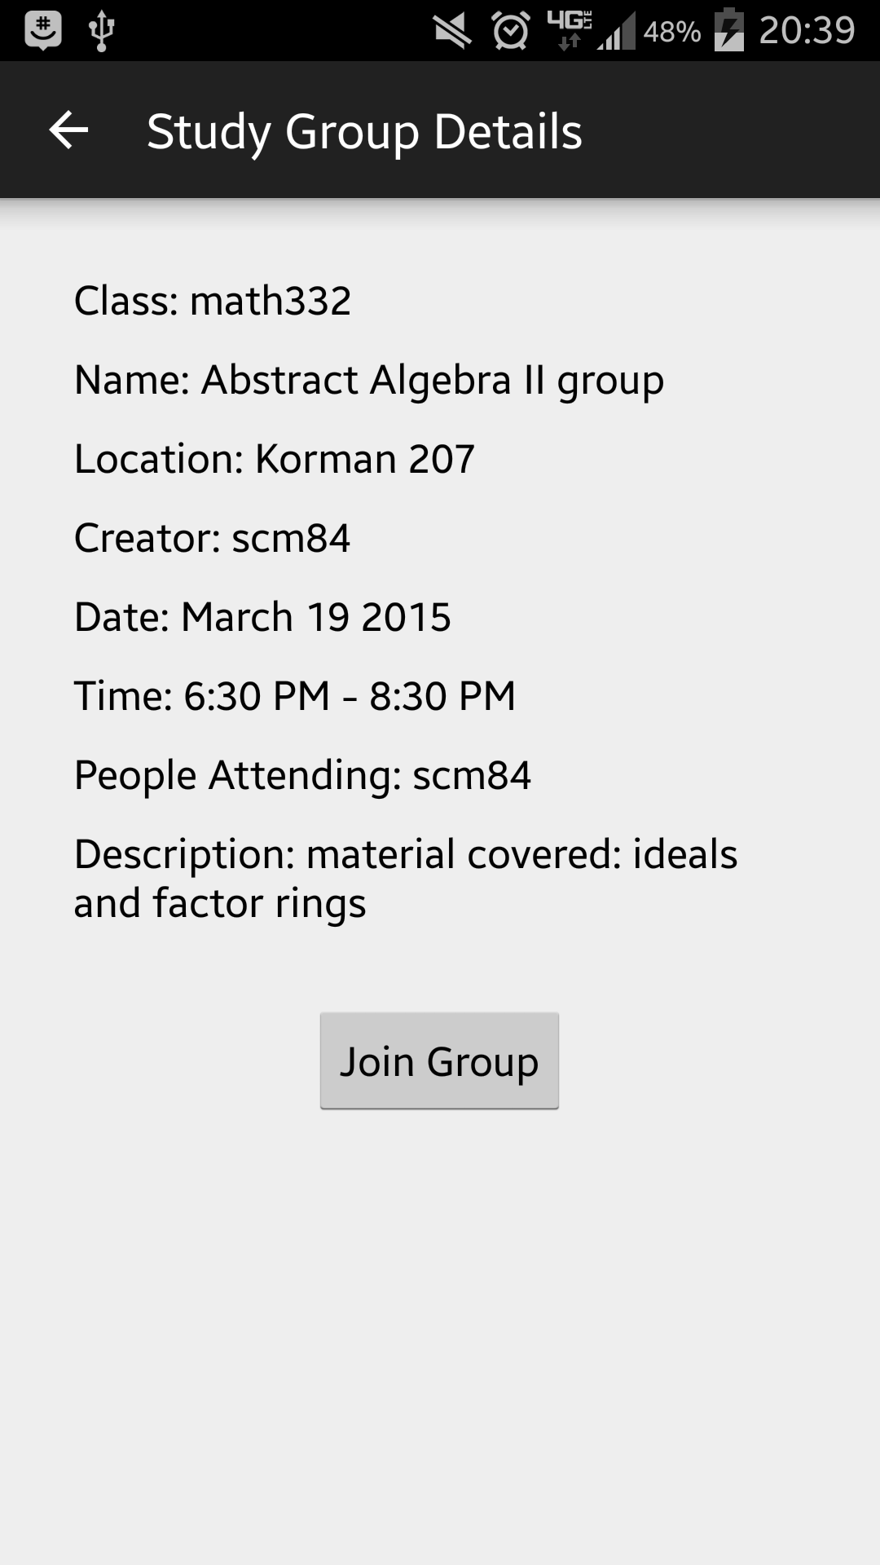
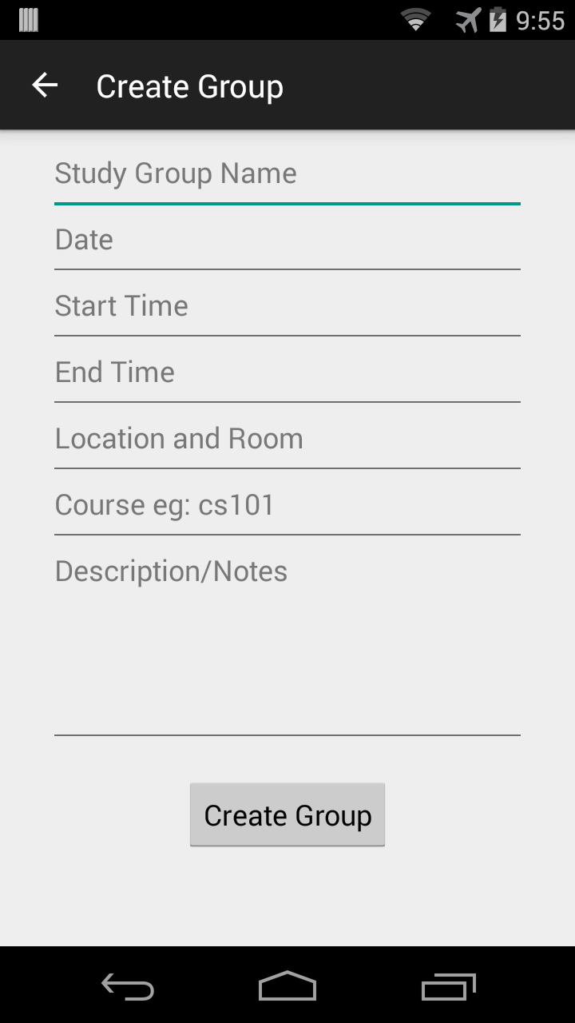

Slide 6
Design Details
Authenticating users against Drexel’s mobile API server and to get list of current student classes
Parse mobile platform used for backend database
CloudCode used for backend logic
Volley and Jackson for mobile JSON parsing and communication
DrexelOne API
App
Parse

Slide 7
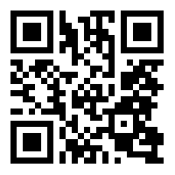
Get The App!
https://play.google.com/store/apps/details?id=com.shemeshapps.drexelstudybuddies

